Slide 1

Education
Attainment in the UK
Group 2
Dania Usman
Jomaris Banua
Shruti Gajre
California State University Eastbay

Slide 2
Does where you grow up determine your educational success?
California State University Eastbay
Notes:
All of us

Slide 3
Research Question
Are students’ educational attainment in UK communities affected by the demographics of their hometowns?
California State University Eastbay
Notes:
Shruti

Slide 4
Hypotheses
Difference between two means
Is there a difference in high school graduation rates between small v large towns/cities?
H₀: There is no mean difference between the high school graduation rates between small v large towns/cities. (μ₁ = μ₂)
H_{A}: There is a difference between the high school graduation rates between small v large towns/cities. (μ₁ ≠ μ₂)
California State University Eastbay

Slide 5

Is there a mean difference in college graduation rates between small v large towns/cities?
H₀: There is no difference in mean college graduation rates between small vs large towns/cities. (μ₁ = μ₂)
H_{A}: There is a difference in mean college graduation rate between small vs large towns/cities. (μ₁ ≠ μ₂)
Difference between two means
California State University Eastbay

Slide 6
Data Overview
Longitudinal Education Outcomes (LEO) Database
Developed by the Department of Education in the UK.
Aggregated and anonymized data ensures privacy.
Students who took their GCSEs (Level 4 qualifications) in 2012-2013, tracked until age 22.
Each data point represents a town or built-up area (BUA) in the UK.
California State University Eastbay
Notes:
Shruti

Slide 7
Data Overview
Variable Name | Type | Description
town11nm | character | Town/city geography name (2011)
size_flag | character | Levels: small_town, large_town
income_flag | character | Variable used to describe towns as lower income deprivation, mid income deprivation or higher income deprivation
key_stage_4_attainment_school_year_2012_to_2013 | numeric | Proportion of pupils that achieved 5 GCSE or more, including English and Maths, with grades A*-C in the 2012 to 2013 school year
highest_level_qualification_achieved_by_age_22_level_6_or_above | numeric | Proportion of the town/city's 2012/13 key stage 4 cohort with level 6 or above qualification at age 22.
California State University Eastbay
Notes:
Shruti

Slide 8

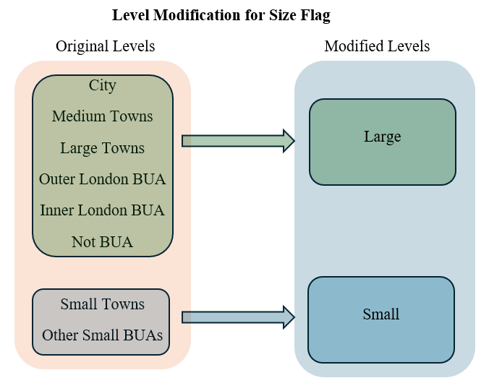
Data Cleaning
Reduced the dataset to variables of interest
Renamed the variables
Changed the character variables to factor
Modified the factor levels for the size_flag
California State University Eastbay
Notes:
Dania

Slide 9

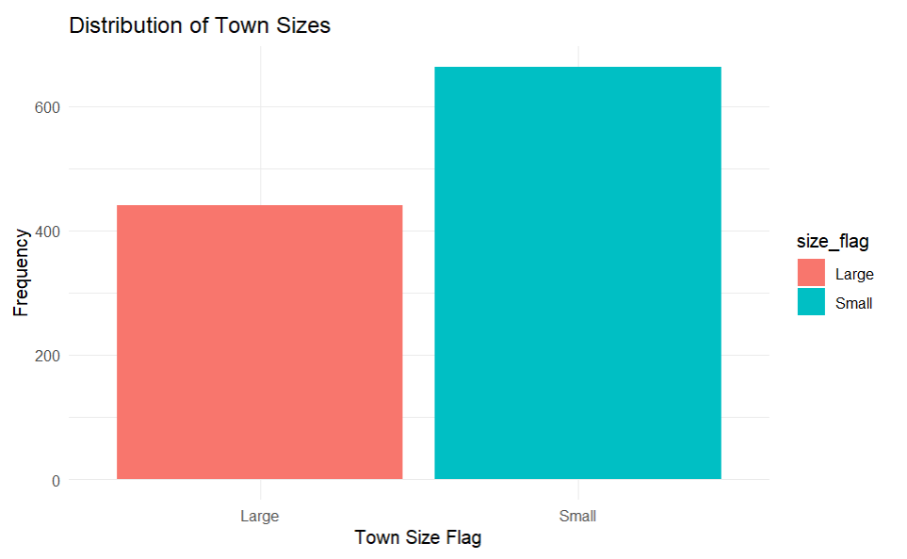
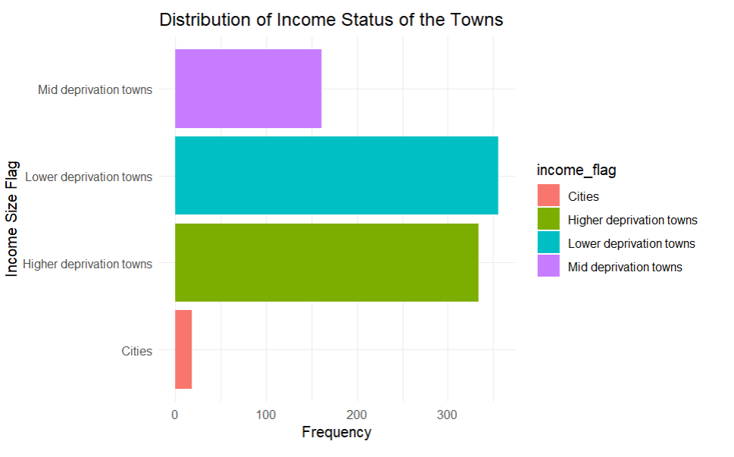
Exploring the Data
California State University East Bay
Notes:
Dania

Slide 10
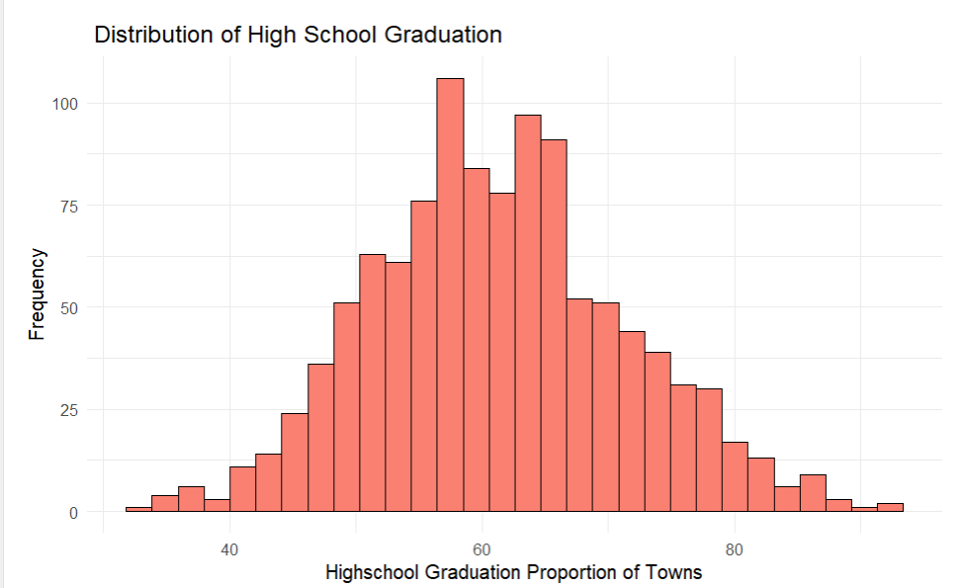
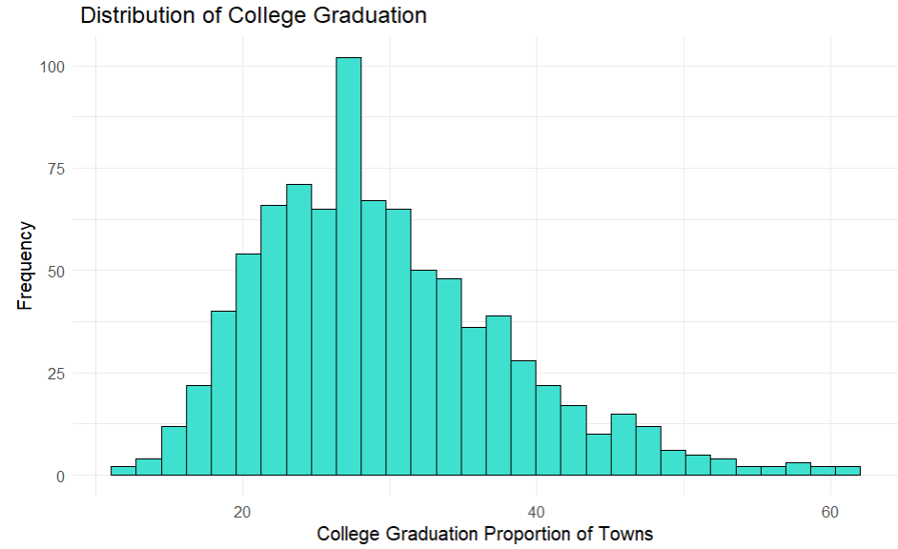
Exploring the Data
California State University East Bay

Slide 11
Summary Statistics
Characteristics | Large (N = 441) | Small (N=663)
Income Flag
Cities | 18 (4.1%) | 0 (0%)
Higher deprivation towns | 221 (50%) | 212 (32%)
Lower deprivation towns | 117 (27%) | 327 (49%)
Mid deprivation towns | 82 (19%) | 123 (19%)
Missing Values | 3 | 1
High school graduation | 60.20 (8.60)* | 62.02 (10.94)*
College graduation | 27.53 (7.39)* | 31.59 (9.02)*
Missing values | 1 | 230
* Mean (sd)
California State University East Bay
Notes:
Dania

Slide 12

Condition Check
Independence of the observations and the two groups
Population normally distributed
Both groups are greater than 30
All conditions are satisfied for a difference in mean hypothesis test
California State University East Bay
Notes:
Dania

Slide 13
Results, Decisions and Conclusions
Difference in mean high school graduation rate
Difference in mean college graduation rate
Test statistic | 3.077
P-value | 0.002
Confidence Interval | (0.658 , 2.974)
Test statistic | 7.260
P-value | 8.864 x 10⁻¹³
Confidence Interval | (2.960 , 5.153)
We have enough evidence to conclude that both the mean high school graduation and college graduation rates are significantly different for small v large towns.
Small towns have higher graduation rates for both high school and college.
California State University East Bay
Notes:
Dania

Slide 14
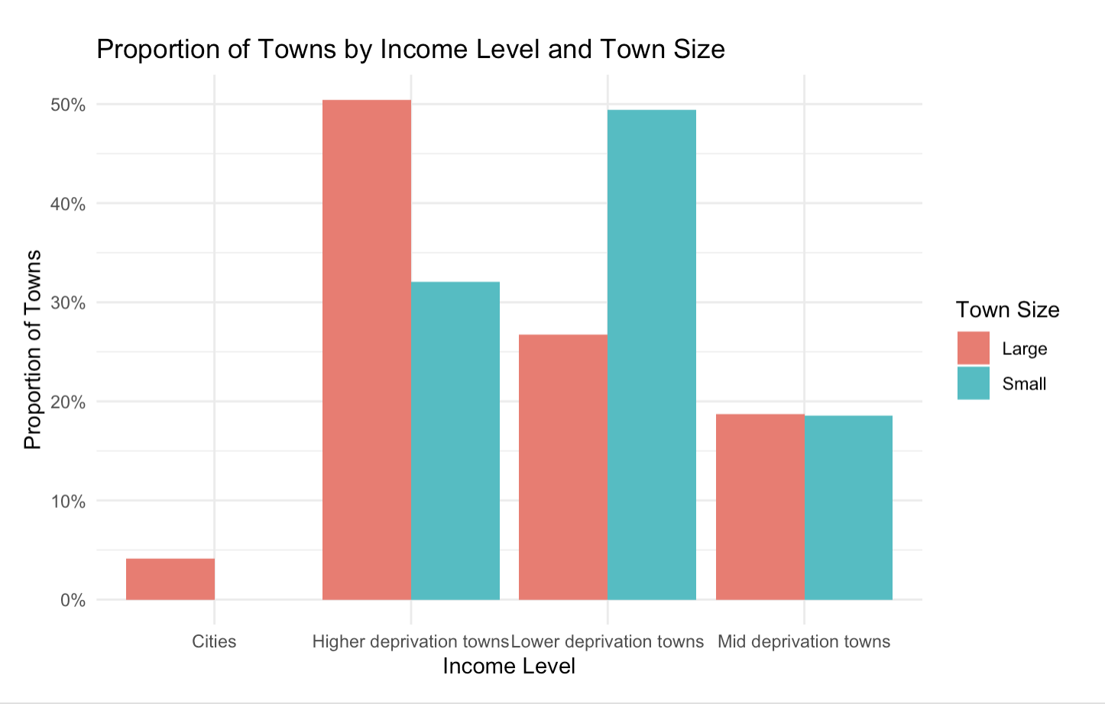
Secondary Analysis
Chi² test of Independence
Are income level and town sizes associated?
H₀: Income ⊥Town Size
H_{A}: Income ⊥̸Town Size
X-squared = 83.562 p-value < 2.2 x 10⁻¹⁶ | Decision: We reject the null hypothesis H₀. | Conclusion: There is strong statistical evidence to conclude that income levels and town size are not independent.
California State University Eastbay
Notes:
Jomaris Association of Income and town size
SLR - high school grad rate v college rate
Include: scatter plot and model Adj R^2
Power Analysis

Slide 15
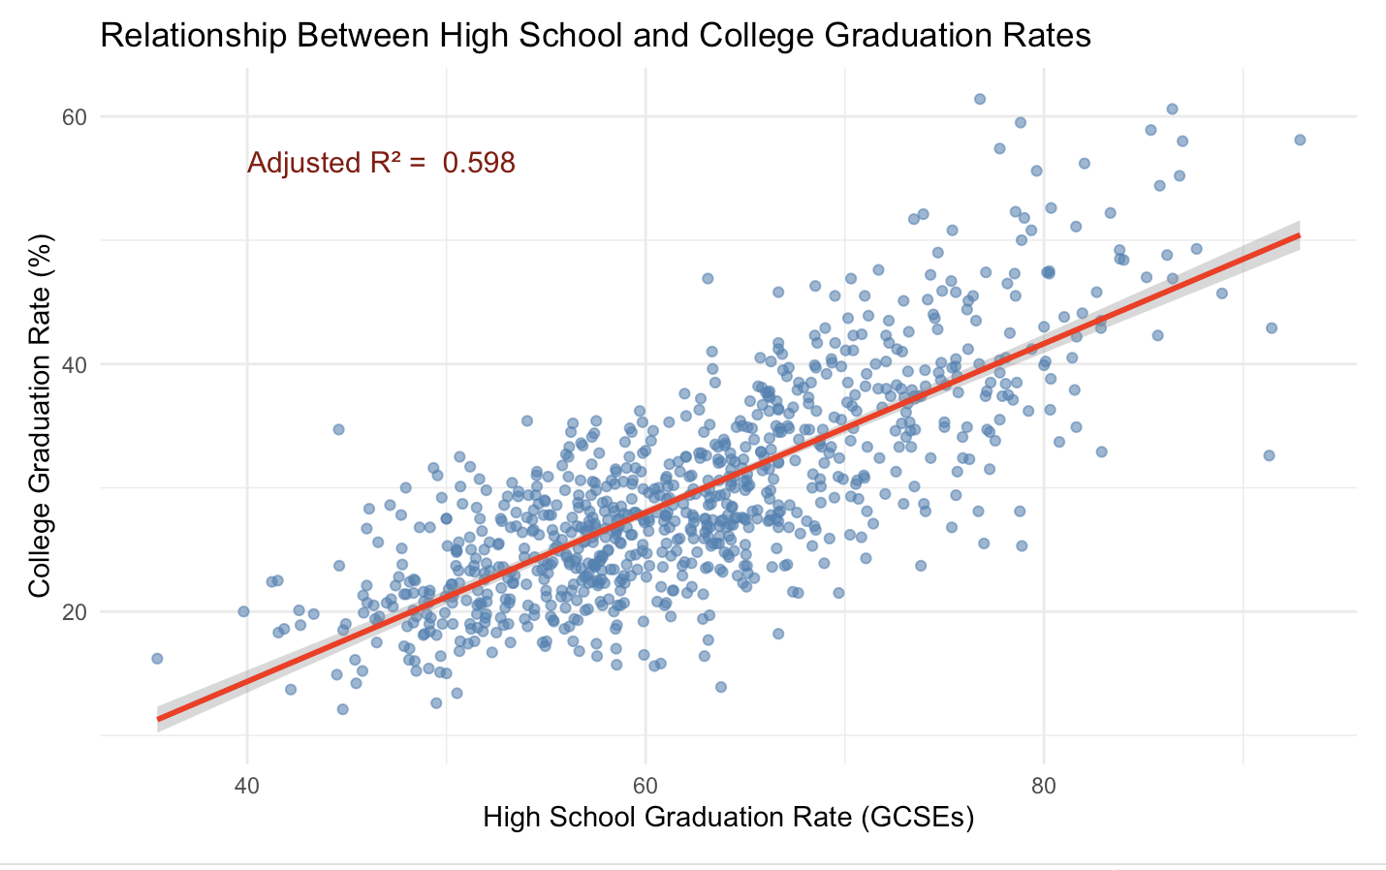
Secondary Analysis
Simple Linear Regression
Is high school completion a good predictor of college degree completion?
H₀: β₁= 0
H_{A}: β₁​≠ 0
p-value < 2.2 x 10⁻¹⁶
Predicted College Graduation Rate = −12.95 + 0.68 ⋅ High school Completion Rate
California State University Eastbay
Notes:
Jomaris Association of Income and town size
SLR - high school grad rate v college rate
Include: scatter plot and model Adj R^2
Power Analysis

Slide 16
Secondary Analysis
Power Analysis
Test | Sample Size | Power
t-Test (High School Grad Rates) | 663, 441 | 0.782
t-Test (College Grad Rates) | 663, 441 | 1.0
Chi-squared Test (Income and Town sizes) | 1100 | 1.0
Linear Regression (High school completion as predictor of college rate) | 1104 | 1.0
California State University Eastbay
Notes:
Jomaris Association of Income and town size
SLR - high school grad rate v college rate
Include: scatter plot and model Adj R^2
Power Analysis

Slide 17



Limitations
1. Unmeasured Variables
2. Specific Cohorts
3. Global Applicability
school quality, student-teacher ratio, etc.
students who sat GCSEs in 2012-2013
specific to the UK
California State University Eastbay
Notes:
Jomaris

Slide 18

Recommendations
Explore factors driving small town success
Investigate the role of income
Assess adult education levels
Conduct cross-country comparisons
Evaluate additional factors
Extracurricular activities
Parental involvement
Student/teacher ratio
School facilities
California State University Eastbay
Notes:
Jomaris

Slide 19
Q&A
Thank you!
California State University Eastbay

Slide 20
References
Why do children and young people in smaller towns do better academically than those in larger towns?
California State University Eastbay

Slide 21
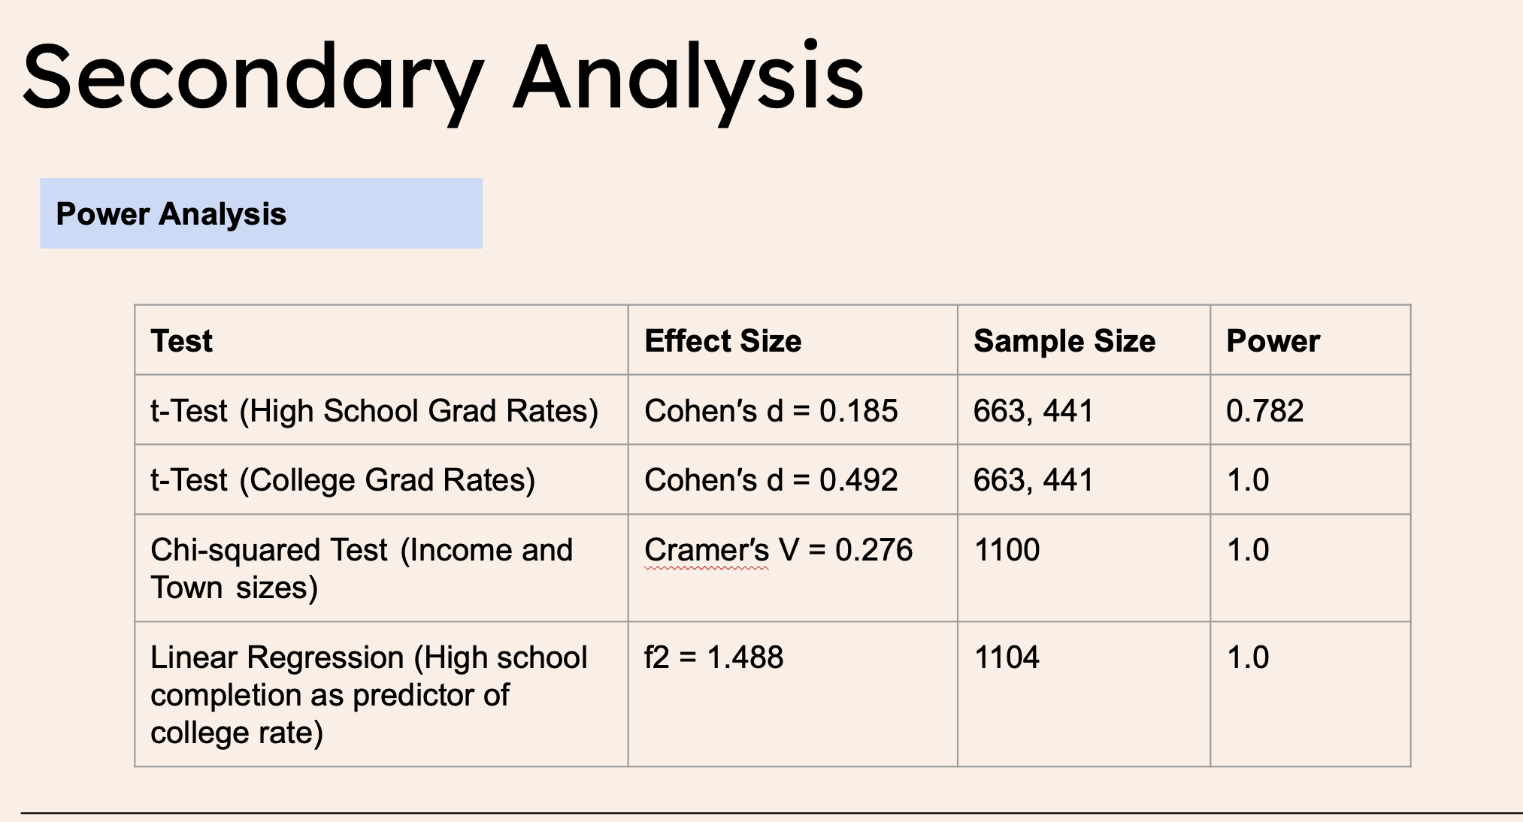
R functions:
pwr.t.test
pwr.chisq.test
pwr.f2.test
California State University Eastbay

